Slide 1

KAIROS
By Gurneesh Singh Banga
SOET – BCA (SPC in AI & DS) 1st Year
Roll No. 2301201009

Slide 2
KAIROS
Ancient Greek: καιρός
A well-timed moment for a decision or action.
kai·ros

Slide 3
What is it about?
It is a Mental Health software which will use AI Action Recognition to track the activities of individuals/groups of people through CCTV footage in classes to analyze their mental and emotional state in real time

Slide 4
Mission & Vision
The mission of Kairos is to look out and support the mental health and wellbeing of students by providing updates and timely notifications to prevent self-harm and help counsellors & therapists promote a happy and healthier lifestyle.
Many cases of self-harm of students are directly linked to their mental and emotional state of mind. Mostly because of stress and depression due to not being able to pass an entrance exam, not being able to attain the desired grades, family disturbances, relationship issues, ragging, bullying, etc.
These occurrences take place as the individual's emotional state of mind is either identified too late or not at all.

Slide 5
Why this is needed
Many cases of self-harm of students are directly linked to their mental and emotional state of mind. Mostly because of stress and depression due to not being able to pass an entrance exam, not being able to attain the desired grades, family disturbances, relationship issues, ragging, bullying, etc.
These occurrences take place as the individual's emotional state of mind is either identified too late or not at all.
This software is not meant to replace Counsellors or Therapists. Rather, it is meant to aid them to monitor & find behavioral patterns in individuals more quickly and efficiently so that timely action can be taken.

Slide 6

By using previous data (reports, video feeds, data on posture & body actions) from public sources, an AI Action Recognition model can be built for tracking the mental/emotional health & wellbeing of individuals.
This software is not meant to replace Counsellors or Therapists. Rather, it is meant to aid them to monitor & find behavioral patterns in individuals more quickly and efficiently so that timely action can be taken.

Slide 7
One of the key features of this software is its ability to identify key actions that relate to specific behavioral patterns and automatically bookmarks red flags in video recordings or livestreams.
By using previous data (reports, video feeds, data on posture & body actions) from public sources, an AI Action Recognition model can be built for tracking the mental/emotional health & wellbeing of individuals.
This software provides real-time monitoring of individuals' behaviors and actions, allowing for the identification of red flags that may indicate the mental and emotional state of mind of an individual.

Slide 8
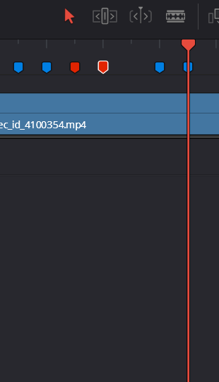
Another feature of this software would be its ability to track the progress of an individual's behavior and mental/emotional state over a period of time.
One of the key features of this software is its ability to identify key actions that relate to specific behavioral patterns and automatically bookmarks red flags in video recordings or livestreams.
This provides a way to analyze these behaviors in more detail and ease. It will also send a notification to the user when a key action has been identified. This feature will allow counsellors to take timely action ensuring no disaster or accident takes place.

Slide 9
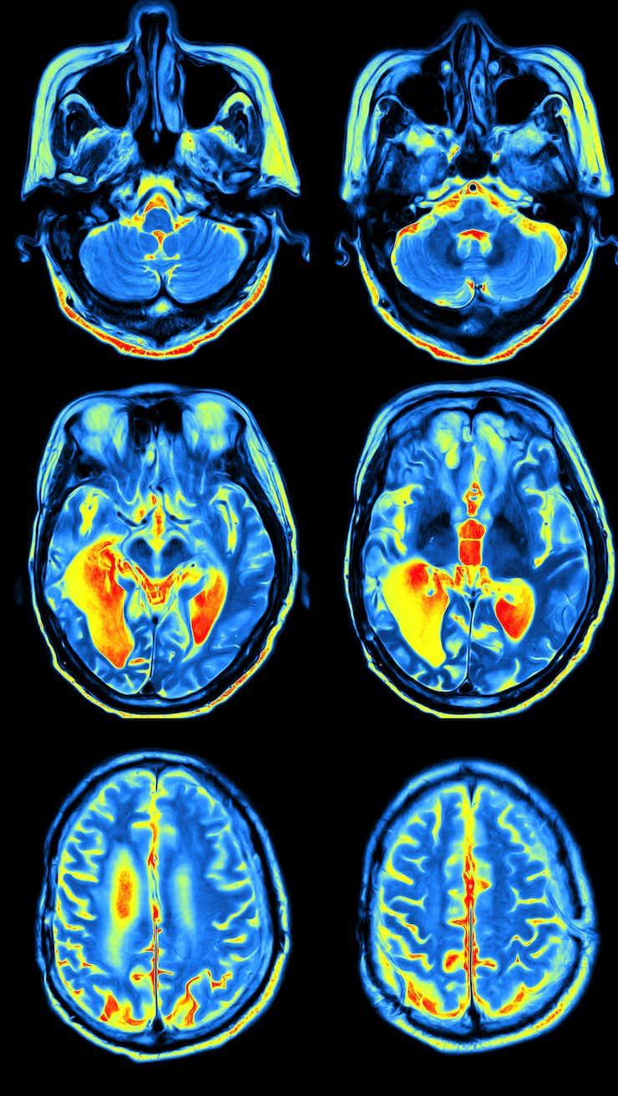
Another feature of this software would be its ability to track the progress of an individual's behavior and mental/emotional state, over a period of time.
Counsellors & hired therapists can gain valuable insights into the effectiveness of various interventions. The data acquired and represented through the software's graphical charts can be used to improve an individual's treatment plan.
By having a set database created by their details and facial recognition, their behaviors and actions can be analyzed over an extended period and create graphical charts to represent change in behaviors.
This Photo by Unknown author is licensed under CC BY-NC-ND.

Slide 10
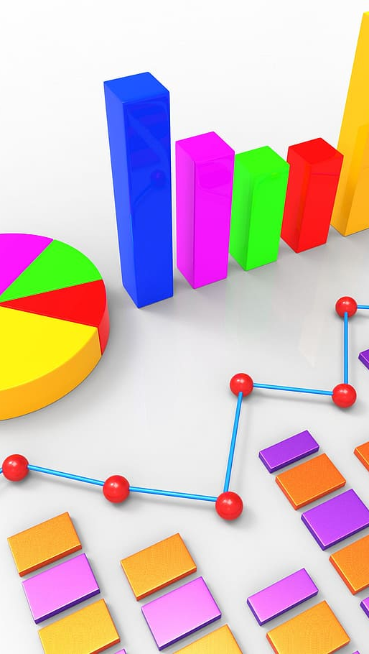

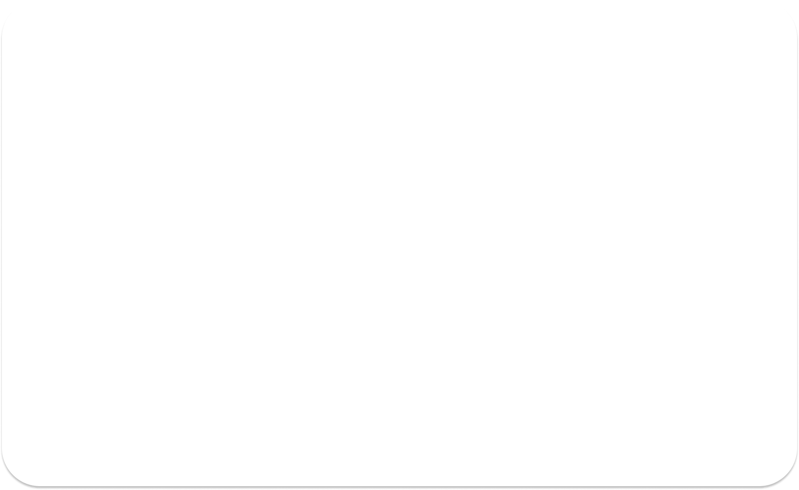
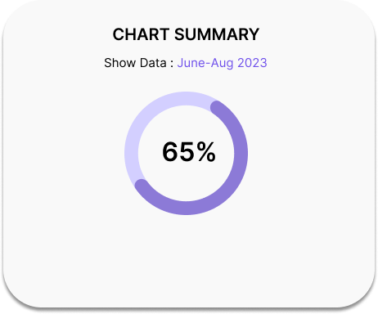
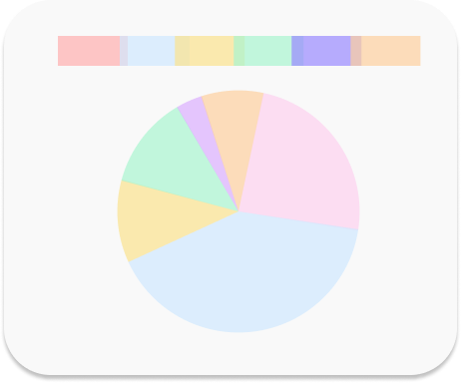
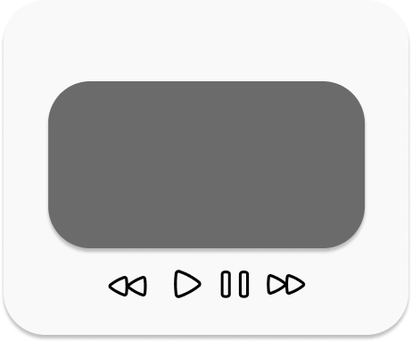

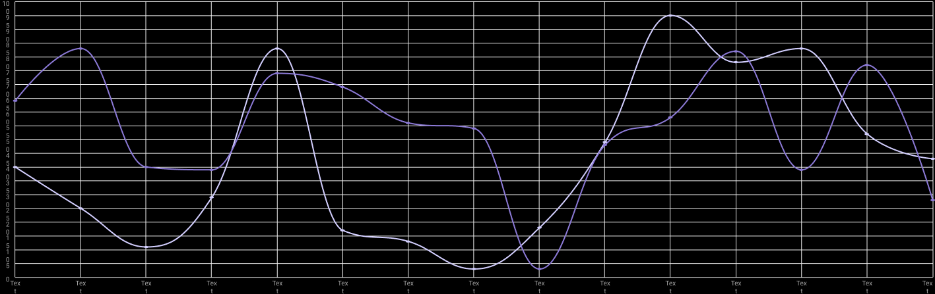
In addition to its monitoring ability, this software will be designed to be user-friendly with easy to recognize logos for different tools. Its interface will be made to navigate with ease.
Counsellors & hired therapists can gain valuable insights into the effectiveness of various interventions. The data acquired and represented through the software's graphical charts can be used to improve an individual's treatment plan.

Slide 11
In addition to its monitoring ability, this software will be designed to be user-friendly with easy to recognize logos for different tools. Its interface will be made to navigate with ease.
Counsellors & hired therapists can gain valuable insights into the effectiveness of various interventions. The data acquired and represented through the software's graphical charts can be used to improve an individual's treatment plan.

Slide 12
BUSINESS MODEL

Slide 13
The primary target for this software would be the Educational Institutes as students are the most emotionally vulnerable. They need extra care and support throughout their journey of self-development.
Educational institutes that prioritize emotional well-being can develop a positive reputation amongst parents, students, and the wider community. This reputation can attract more students and enhance the institution's value & respect which would ultimately lead to long-term sustainability & relevance and also influence other institutions to take the same steps to stay as a viable option amongst parents and students.
This would also count as free marketing for the software.

Slide 14
Software as a Service (SaaS) Model
The software could be offered as a SaaS, where customers pay a monthly or annual subscription fee to use the service.
Subscriptions will provide a steady and predictable stream of revenue. This will allow for better investment in product improvement, and overall business growth.
Educational institutes can opt for a subscription that suits their budget and needs. This makes the software accessible to a wide range of institutions, from small schools to large universities.
Subscribers can easily adjust their subscription plans based on changing needs. This ability allows them to scale up or down as circumstances dictate.

Slide 15
Data Privacy and Security
Given that a lot of sensitive video data will be handled, security and privacy should be the top priority. We will implement encryption, access controls, and compliance measures to protect customer data, personal records and comply with the necessary laws.

Slide 16
Customer Support
Providing excellent customer support to address user issues promptly will be one of the priorities as this can significantly impact customer satisfaction and retention.
In the event of a security breach or any other critical issue, customer support plays a pivotal role in communication and crisis management. Transparent and clear communication can help mitigate potential negative impacts.
When institutions receive exceptional assistance and value from the software provider, they are more likely to continue their subscription and recommend the software to others.

Slide 17
Pricing Strategy
There would be different levels & plans of subscription which a potential client can choose through.
They can choose through either Basic, Premium and Pro. With each of them having added benefits the which the previous plan doesn't offer. Which includes the amount of cloud storage for videos.
Each plan would have a payment option of Monthly, Quarterly or Annually.

Slide 18
LET'S GET TECHNICAL

Slide 19
CODE IMPLEMENTATION
For this software we'll be working with Python
Importing necessary modules/libraries
Collect a dataset of videos of mental/emotional imbalances and normal events
Pre-process the video data by extracting features such as color and motion
Training and evaluating a machine learning model on the pre-processed videos
Using the trained model to predict whether a new video shows an event of mental/emotional imbalance or not
Creating and sending a notification

Slide 20
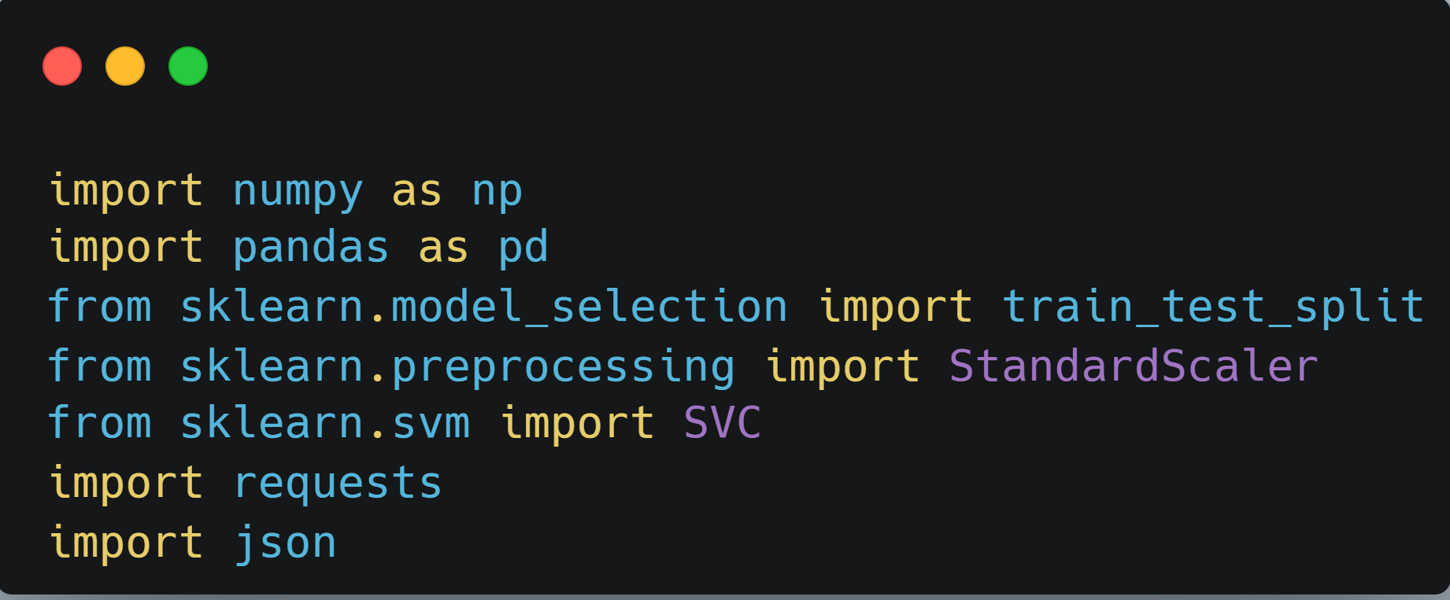
Importing Necessary modules/libraries
Firstly we'll be importing numpy to perform a few operations on arrays & matrices, pandas to analyze big data, and a few modules from sklearn to implement the machine learning model, preprocessing and statistical modelling.
We are importing requests to create code to send notifications to the user. The json module is used to serialize the message object into a JSON string, which is then sent to the user. When the user receives the notification, they can then deserialize the JSON string back into a message object, which they can then use to take appropriate action.

Slide 21
Importing Necessary modules/libraries
Firstly we'll be importing numpy to perform a few operations on arrays & matrices, pandas to analyze big data, and a few modules from sklearn to implement the machine learning model, preprocessing and statistical modelling.
We are importing requests to create code to send notifications to the user. The json module is used to serialize the message object into a JSON string, which is then sent to the user. When the user receives the notification, they can then deserialize the JSON string back into a message object, which they can then use to take appropriate action.

Slide 22
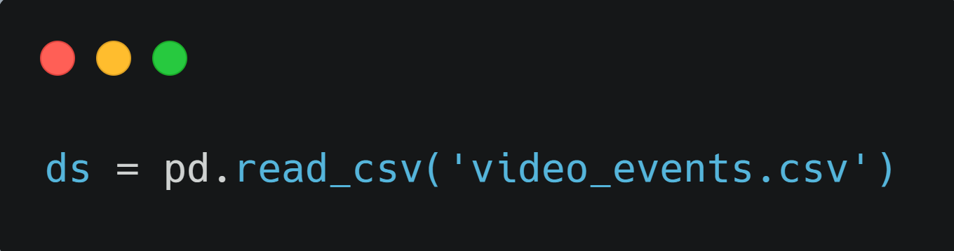
Collect a dataset of videos of mental/emotional imbalance events and normal events
We'll be using pd.read_csv() to load the dataset onto the code. This command reads a comma-separated values (csv) file into the DataFrame. The CSV file will have the following columns: - Video ID - Video URL - Video Label

Slide 23
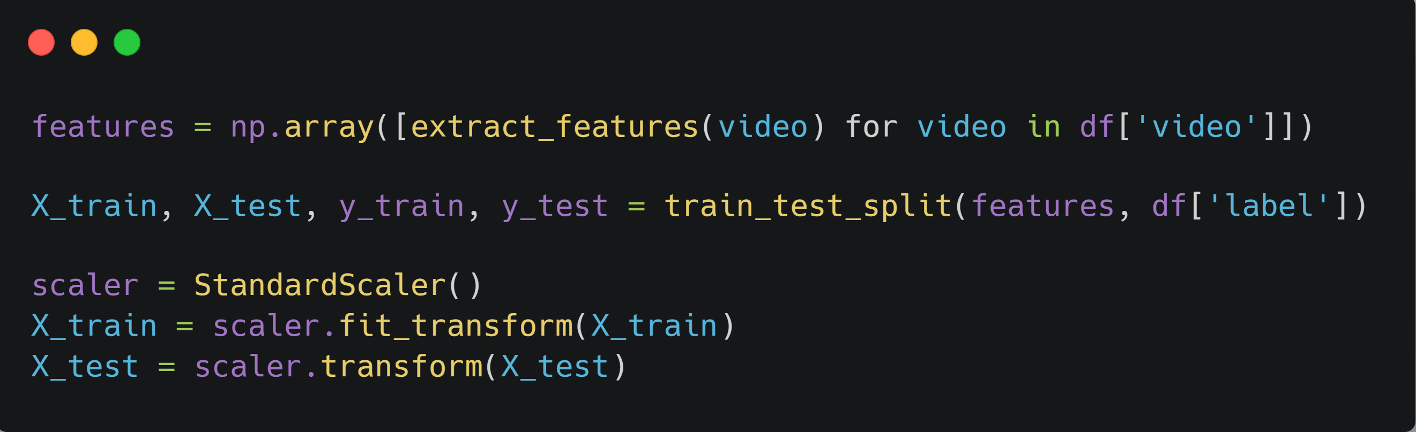
Pre-process the video data by extracting features such as motion & color
Firstly we'll use create an array using np.array and use extract_features to extract features automatically from the given dataset so that the model is trained on the most relevant data without the need for human intervention.
Next, the dataset has to be split into training and testing sets to avoid overfitting. Training data trains the model while testing checks whether this built model works correctly or not.

Slide 24
Pre-process the video data by extracting features such as motion & color
Firstly we'll use create an array using np.array and use extract_features to extract features automatically from the given dataset so that the model is trained on the most relevant data without the need for human intervention.
Next, the dataset has to be split into training and testing sets to avoid overfitting. Training data trains the model while testing checks whether this built model works correctly or not.

Slide 25
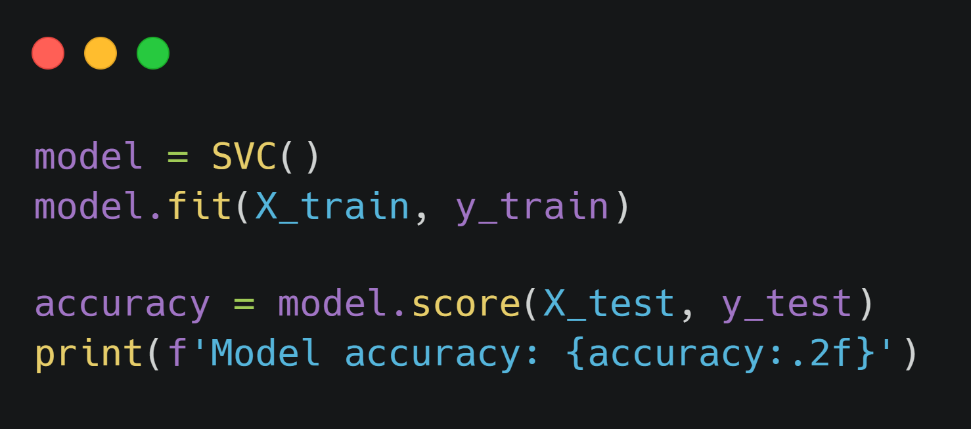
Training and evaluating a machine learning model on the pre-processed videos
For training the model, we will use the SVC() function that implements a support vector classifier used for classification tasks between two classes of data. Then, we will take a number of arguments which includes the training data by using model.fit(). This method will train the model using the training data and the target values, and it will then return a trained model.
To evaluate the accuracy of the model we use model.score() which will return a score that indicates how well the model performed on the test data and then print it.

Slide 26
Training and evaluating a machine learning model on the pre-processed videos
For training the model, we will use the SVC() function that implements a support vector classifier used for classification tasks between two classes of data. Then, we will take a number of arguments which includes the training data by using model.fit(). This method will train the model using the training data and the target values, and it will then return a trained model.
To evaluate the accuracy of the model we use model.score() which will return a score that indicates how well the model performed on the test data and then print it.

Slide 27
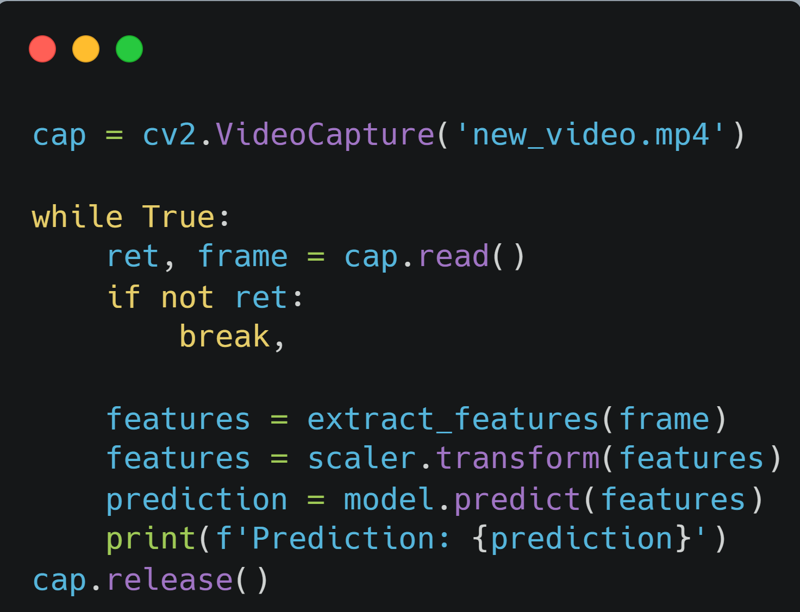
Use the trained model to predict whether a new video shows an event of mental/emotional imbalance or not
First we'll load the video using cv2.VideoCapture()
Now we will create a while loop to run frame by frame using cap.read(). It returns a bool ( True / False ). If the frame is read correctly, it will be True.
We'll extract the features from the frame using extract_features(). This function is responsible for extracting features from the video frames, such as the color or motion.
Then we'll scale the features using using scaler.transform(). to transform the features of the data set by scaling them to a specific range which improves the performance of a machine learning model
Next prediction will be made using model.predict(). This function takes the features of the data as input and returns the predicted labels.
And finally, the prediction will be printed using print()

Slide 28
Use the trained model to predict whether a new video shows an event of mental/emotional imbalance or not
First we'll load the video using cv2.VideoCapture()
Now we will create a while loop to run frame by frame using cap.read(). It returns a bool ( True / False ). If the frame is read correctly, it will be True.
We'll extract the features from the frame using extract_features(). This function is responsible for extracting features from the video frames, such as the color or motion.
Then we'll scale the features using using scaler.transform(). to transform the features of the data set by scaling them to a specific range which improves the performance of a machine learning model
Next prediction will be made using model.predict(). This function takes the features of the data as input and returns the predicted labels.
And finally, the prediction will be printed using print()

Slide 29
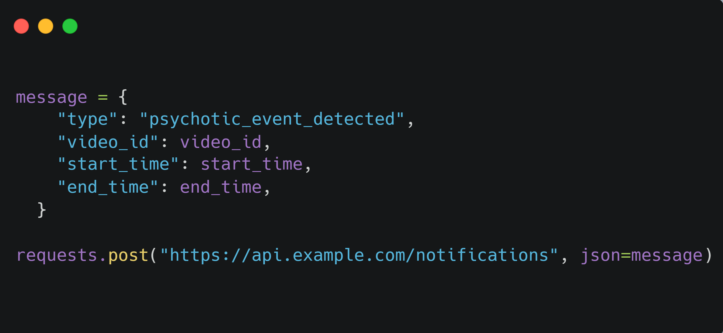
Creating and sending a notification
The code first creates a message object that contains the following information:
The type of event that was detected. In this case, the event is emotional imbalance.
The ID of the video in which the event was detected.
The start time of the event.
The end time of the event.
The message object is then sent to the user using the requests.post() function. The requests.post() function takes two arguments: the URL of the API endpoint to which the message should be sent, and the message object itself. When the user receives the notification, they can then take appropriate action, such as watching the video to see if they can identify the event, or contacting a mental health professional for help.

Slide 30
Creating and sending a notification
The code first creates a message object that contains the following information:
The type of event that was detected. In this case, the event is emotional imbalance.
The ID of the video in which the event was detected.
The start time of the event.
The end time of the event.
The message object is then sent to the user using the requests.post() function. The requests.post() function takes two arguments: the URL of the API endpoint to which the message should be sent, and the message object itself. When the user receives the notification, they can then take appropriate action, such as watching the video to see if they can identify the event, or contacting a mental health professional for help.

Slide 31
What Database is being used?
So the database being used for this particular project is called as
"HACER Human Action and Emotion Recognition" uploaded on Kaggle by Siwar Ammar. This unique dataset, which includes both action and emotion categories, offers a valuable resource for developing machine learning models capable of recognizing both types of information from visual data.
Link for reference - https://www.kaggle.com/datasets/siwarammar/hacer-human-action-and-emotion-recognition?resource=download

Slide 32
THANK YOU

